Slide 1
Assignments and Case Studies

Slide 2
AGENDA
Introduction
Problem Statement and Data Source
Objective
Solution Description
Impact

Slide 3
CASE STUDY 1

Slide 4
Introduction
A man has took a shop on rent near BTM Layout, Bangalore, not onb the main road but local shop. The rent of the shop is 14000 per month. The man took the shop to sell fast food like - Biryani, Maggi, Egg Bhujiya, Omlets, Chicken Kabab, etc.

Slide 5
Problem Statement and Data Source
A man has took a shop in Rent near BTM Layout, Bangalore, not in the main road but as a local shop. The rent of the shop is 14000 per month. The man took the shop to sell fast food like - Biryani, Maggie, Egg Bhurjia, Omllettes, Chicken Kabab etc.
a. In the first 3 months he make a profit of around 100000, with a sales of around 300000.
b. In the 1st month he was selling veg food also, but he stopped after the 2nd month as it stock was not getting out.
c. After 4 – 5 months down the line the man is making a huge loss in his investment. He has a due of 2 months to pay the rent.
d. The sale has drastically gone down and he is thinking to close the shop.
How will you tackle a situation of this kind? Write a solution to this kind of problem. Give a Fact-full answer by understanding the critical problems

Slide 6
Objective
To understand what will be solution for the problems faced by vendor using the available data.

Slide 7
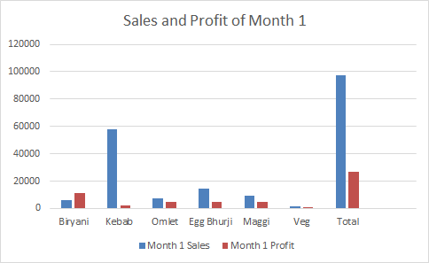
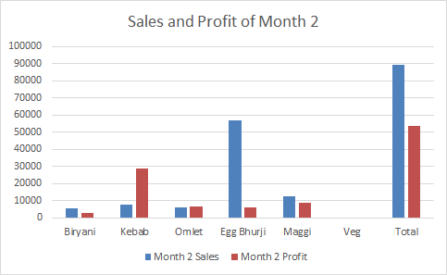
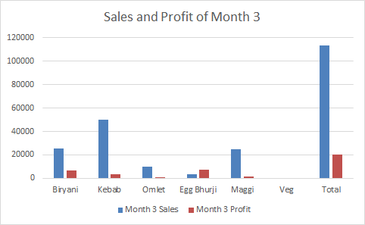

Slide 8
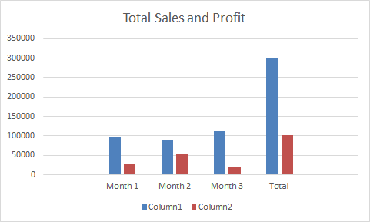

Slide 9
Sales and Profit trends

Slide 10
Solution
Concentrate on improvement of food quality.
Check on service improvement.
Change the way of approach for your service.
Improve customer experience.
Identify and fix income leakage.
Observe weather any new hotels are opened nearby so that to be aware of the competition around so as to take appropriate action.

Slide 11
CASE STUDY 2

Slide 12
Introduction
A man wants to open a Wada Pav Shop near Shivaji Nagar in Pune. He has got a location where there are other 4 more wada pav shops. He is not able to understand what will be the strategy to take over his clients.

Slide 13
Problem Statement and Data Source
A man wants to open a Wada Pav Shop near Shivaji Nagar in Pune. He has got a location where there are other 4 more wada pav shops. He is not able to understand what will be the strategy to take over his clients.
a. What will be the price of each Wada Pav?
b. How will he differentiate from the other competitors?
c. How will you bring insights when he has no data of his shop?
d. Why will be the Customer comes to your shop? (What will be the positioning)
e. What Machine Learning Models you will used to take to solve this Problem Statement?
Whether Data Science is really required or not? How will you come to a solutions which will make him an entrepreneur and will help him to grow?

Slide 14
Objective
To identify solutions which will make the business of the vendor grow and make him a good entrepreneur.

Slide 15
Solution
The price of each vadapav should be reasonable compared to other 4 vendors.
There should be different and unique varieties of vadapav at his shop so as to attract more customers.
Insights can be bought by making attractive marketing strategies.
Customers should get attracted to the shop by its service, food quality, variety, taste, cleanliness, hygiene, attractive shop, etc,

Slide 16
Impact
The impact after using these marketing strategies will help the vadapav vendor grow is business and become a successful entrepreneur.

Slide 17
THANK YOU!

